Slide 1
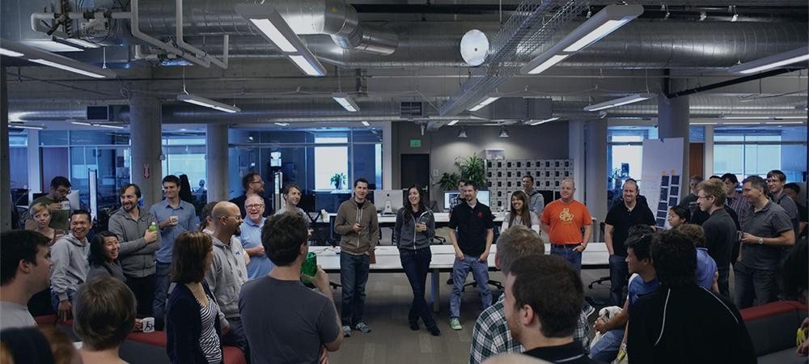
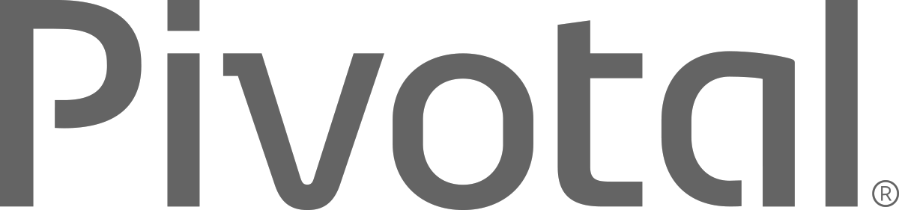
Introductions
Name, Team, Apps

Slide 2


Cloud Native Applications
Workshop Introduction
Notes:
I want to talk to you about cloud native applications, microservices and the platforms for bringing them to production

Slide 3
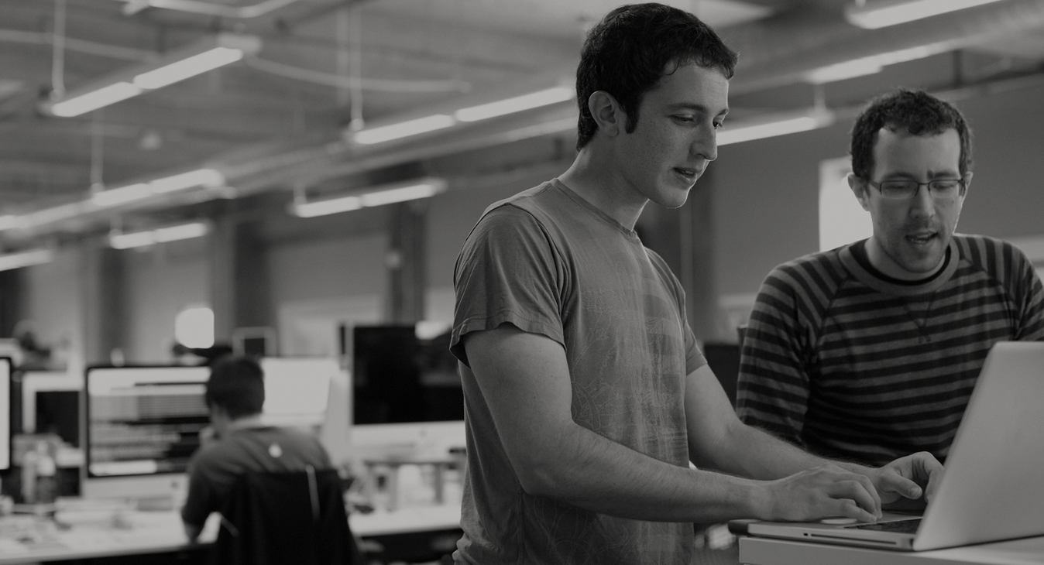

WE BELIEVE
Transforming how the world builds software will shape the future.
Notes:
At Pivotal, we believe Transforming how the world builds software will shape the future.
This is our core guiding principle that shapes our product and corporate strategy

Slide 4
Agenda
Changing Development Models
Cloud Native Application Platforms
Pivotal Cloud Foundry

Slide 5
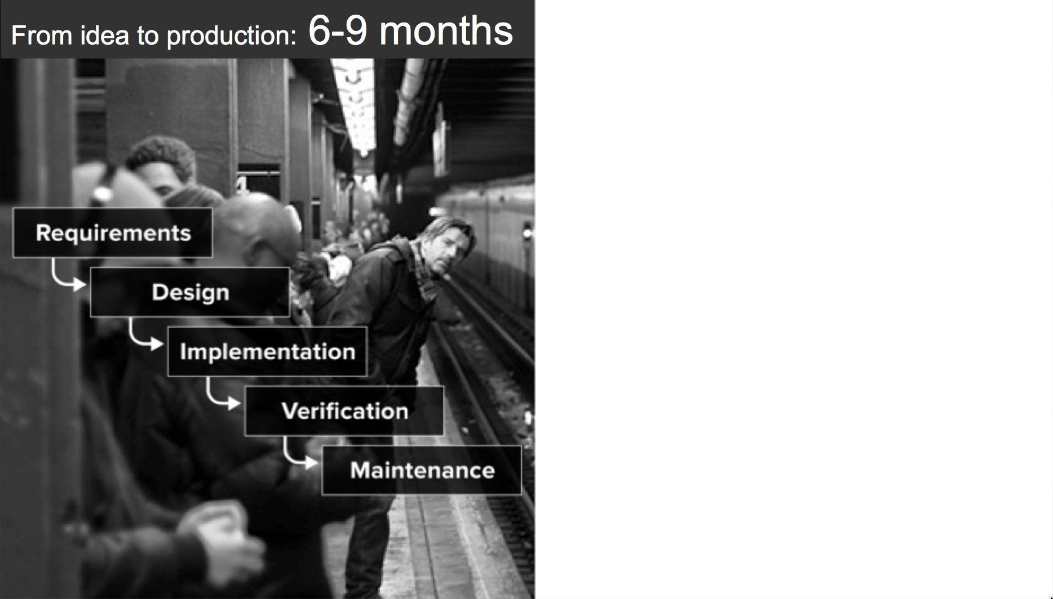
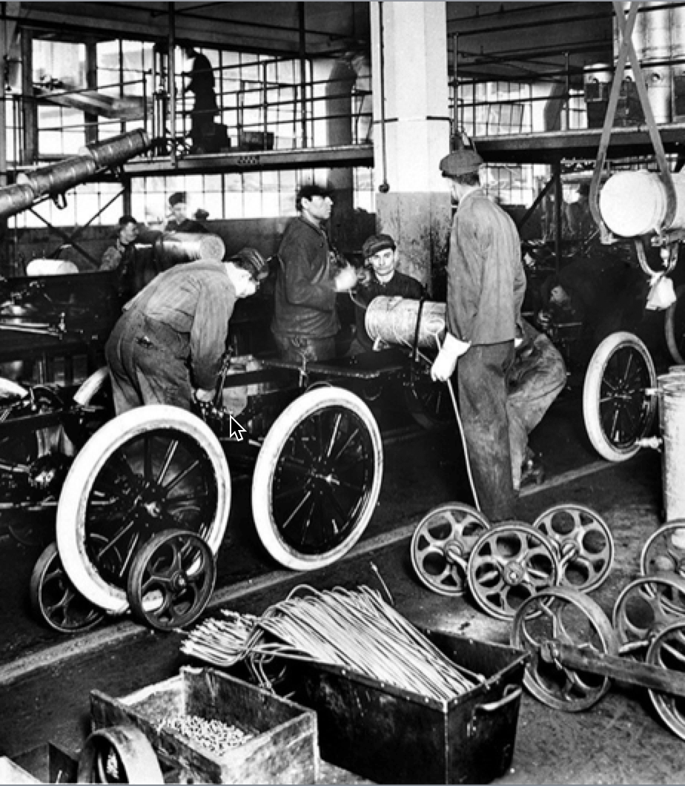
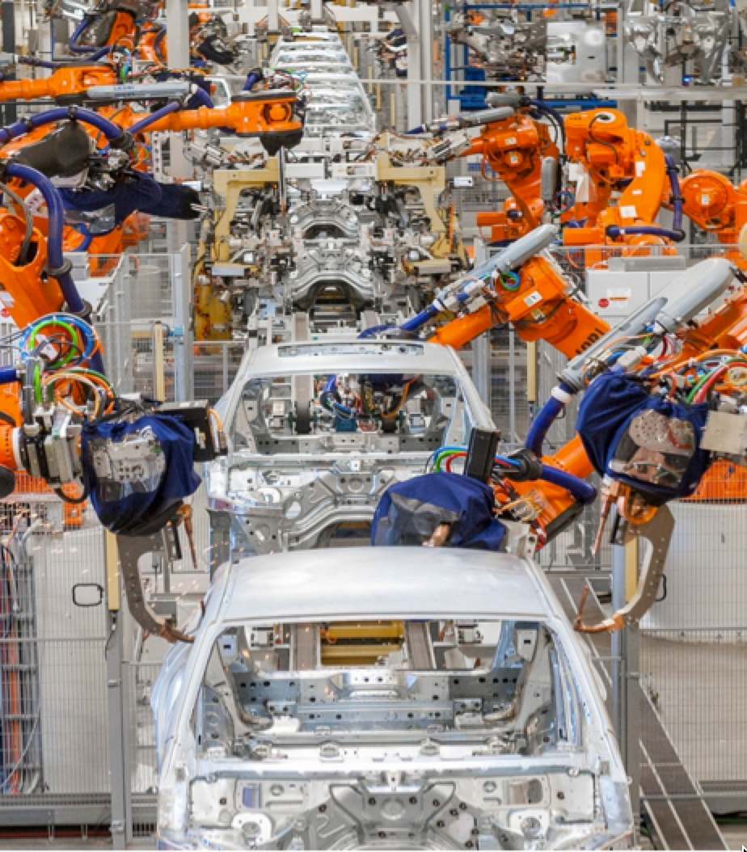
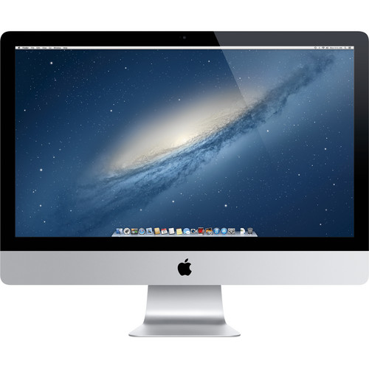
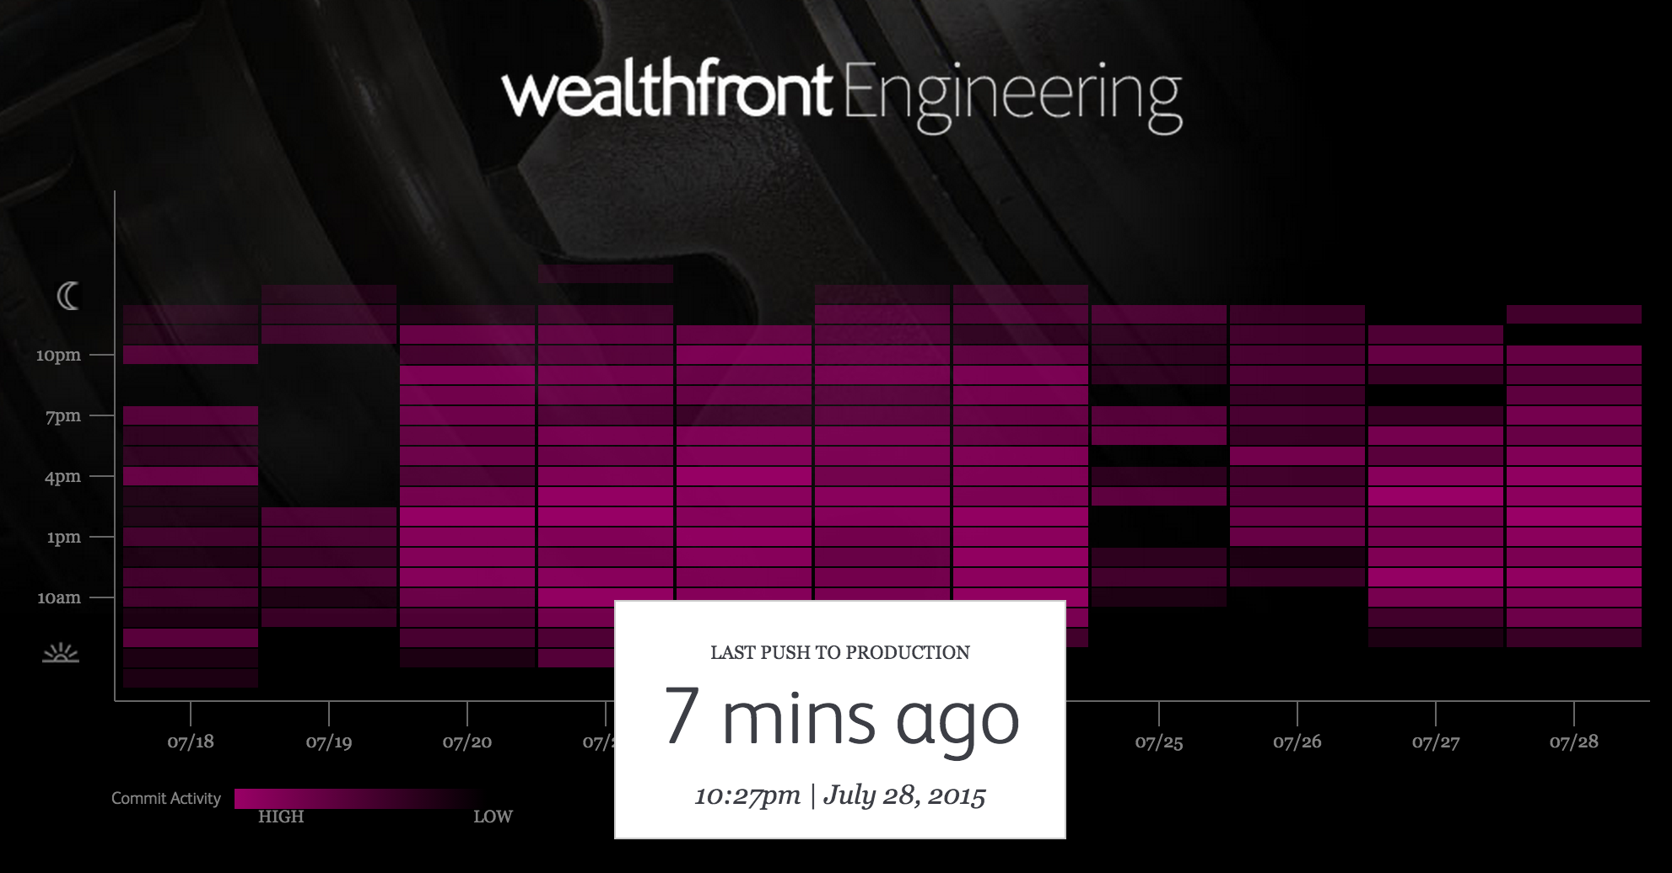
An idea in the morning, is running in production by evening
Then
Now

Slide 6
Software Developers Spend too Much Time NOT Writing Software
Design and Coding
Brainstorming
Administrative tasks
Managing Environments
Waiting for Test/Build
Average Hours/Week
Sources: “Electric Cloud LinkedIn Survey to software developers”

Slide 7
The Developer DREAM Haiku
Here is my source code,
Run it in the Cloud for me,
I do not care how

Slide 8
The IT Operator REALITY
It's not enough just to deploy something
That's only Day One
You have to deploy again and again and again

Slide 9
IT Ops Spends Time Building Snowflakes
Request VMs
Request Network
Request Software Install
Request Database
Random Network Troubleshooting
DAYS
14
4
4
8
6
11
40
14
60
2
Nearly 6 months later
Random Middleware/OS Troubleshooting
Develop App
User Acceptance Testing
QA/Production Deploy Pipeline
Scale Up/Down

Slide 10






Software is changing INDUSTRIES
$6BN
Financial Services
$53BN
Entertainment
$26BN
Hotel
$34BN
Automotive
$50BN
Transportation
$3.2BN
Industrial Products

Slide 11



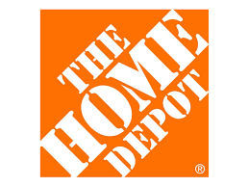
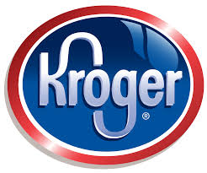
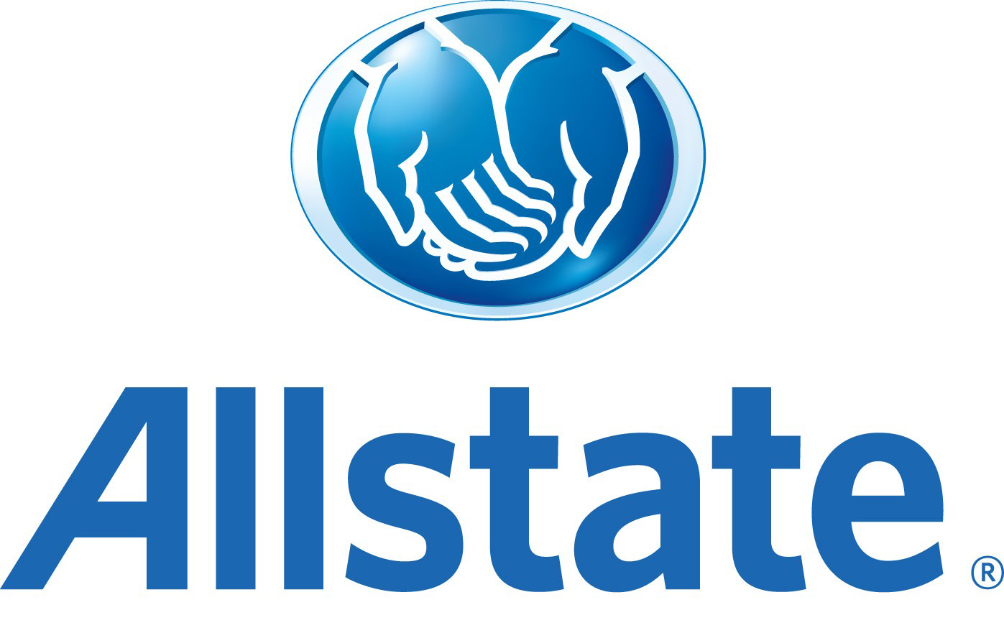
The enterprise REVOLUTION
$138BN
$62BN
$34BN
$145BN
$108BN
$23BN

Slide 12
The enterprise REVOLUTION
700+ apps
Spring + PCF
Re-writing software the modern way
Agile software transformation
DevOps adoption with PCF
Automated build pipeline
Major IT transformation

Slide 13
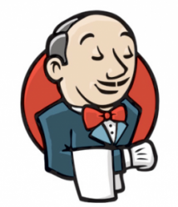
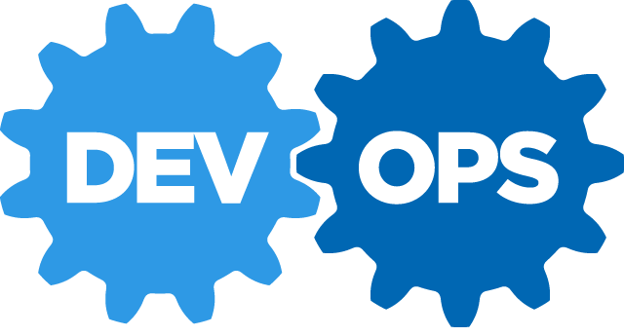
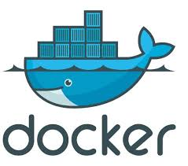
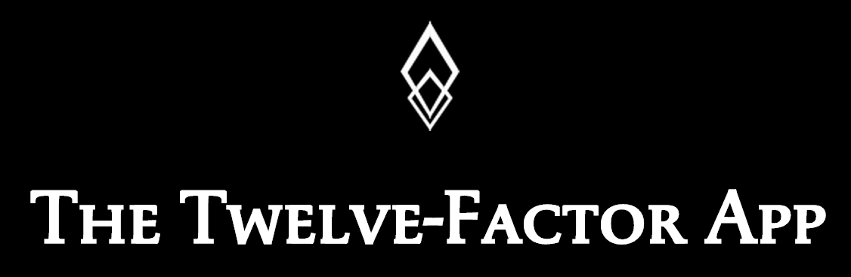
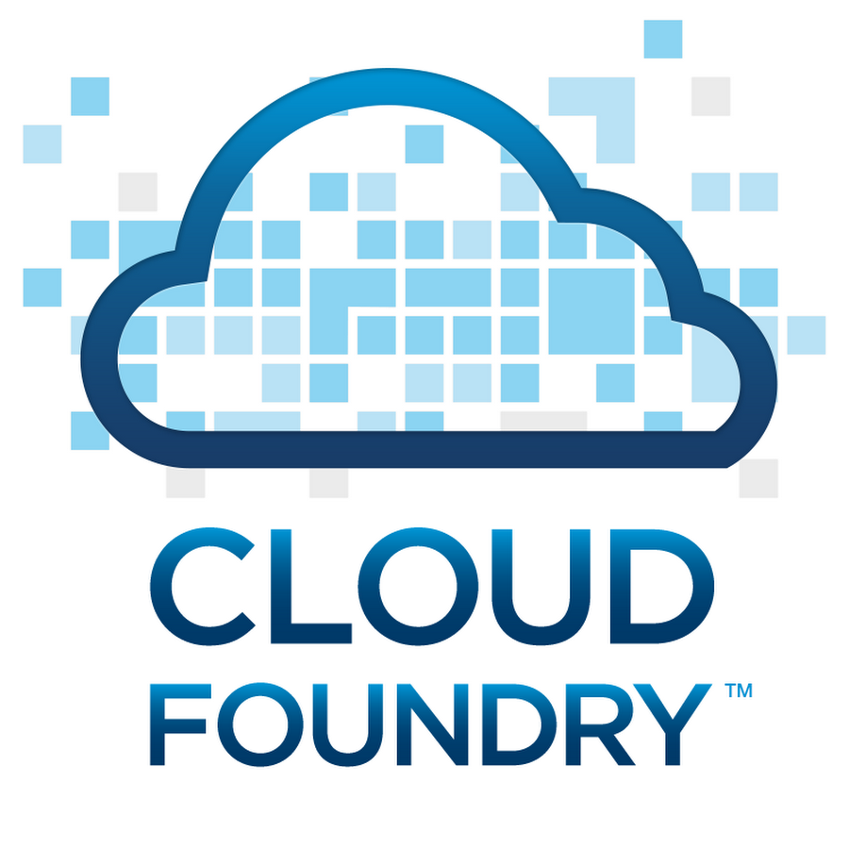

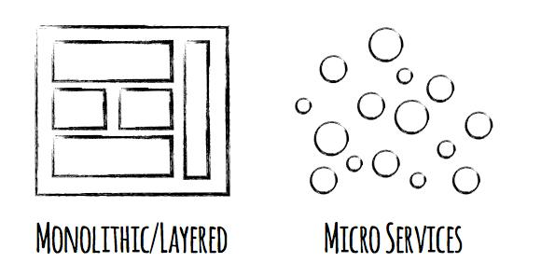

Software is CHANGING
Continuous Delivery
Spring Boot

Slide 14
DevOps
Continuous Delivery
Microservices
Not my problem
Separate tools, varied incentives, opaque process
Release once every 6 months
More Bugs in production
Tightly coupled components
Slow deployment cycles
Shared responsibility
Common incentives, tools, process and culture
Release early and often
Higher Quality of Code
Loosely coupled components
Automated deployments
Notes:
Speak to each

Slide 15
It Takes a Platform
An end-to-end structured platform that makes implementing distributed application best practices, a turn-key and first practice

Slide 16
Cloud Native Application Platforms
Business Value, Agility & Cost Savings
Traditional IT
IaaS
Cloud Native
You Manage
Applications
You Manage
Applications
Applications
Data
Data
Data
You Manage
Runtime
Runtime
Runtime
Middleware
Middleware
Middleware
Pivotal CF
+
Choice of IaaS
O/S
O/S
O/S
Virtualization
Virtualization
Virtualization
Servers
Servers
IaaS
Servers
Storage
Storage
Storage
Networking
Networking
Networking

Slide 17


D e m o
Notes:
Scale Demo – its the fastest to stage

Slide 18
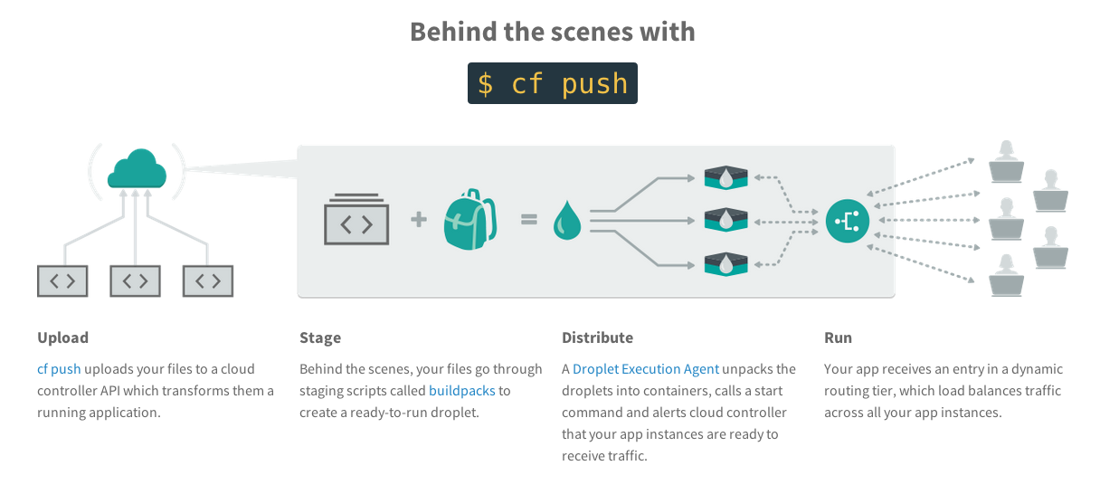
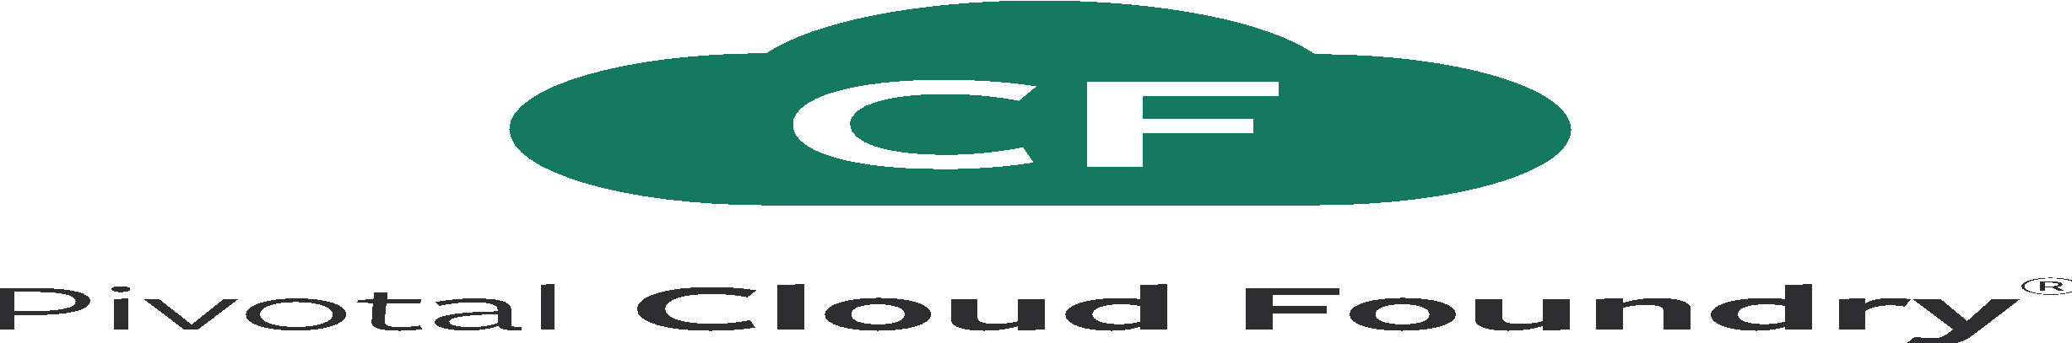
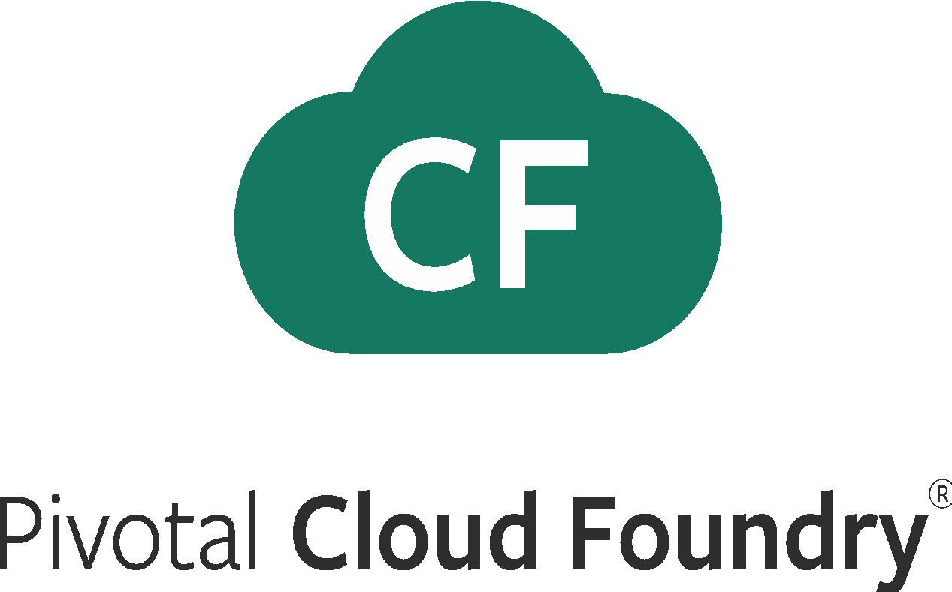
What Just Happened

Slide 19
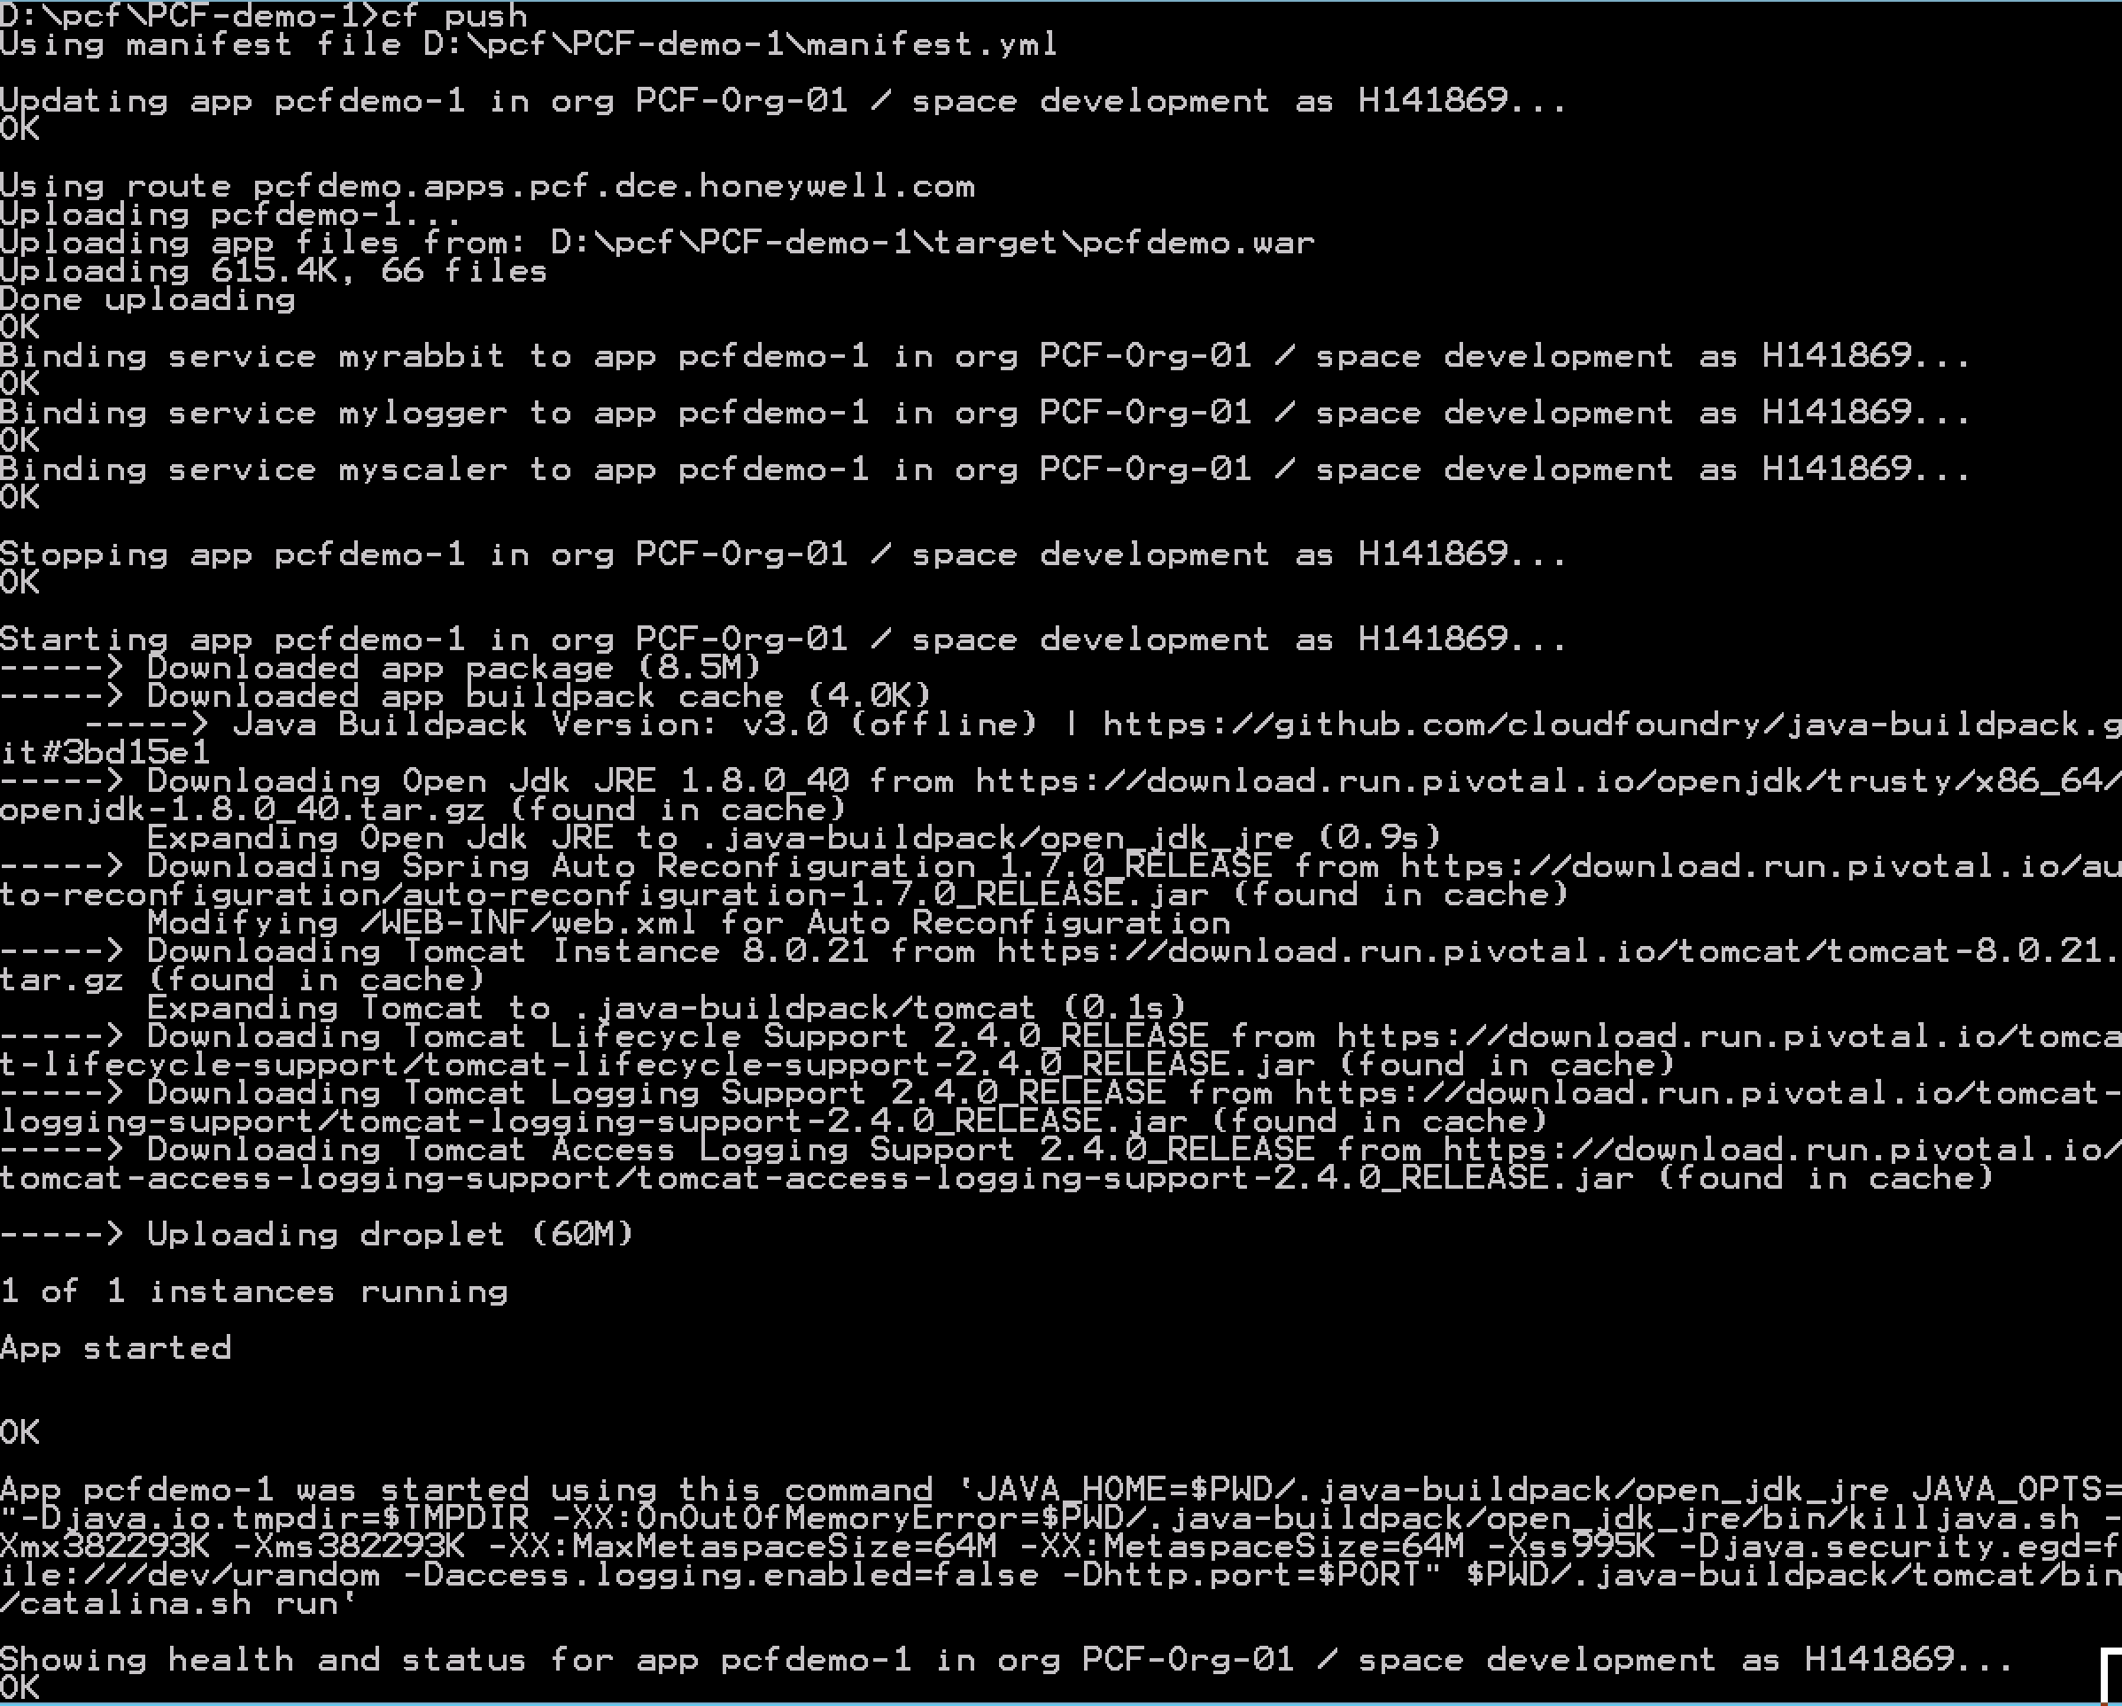
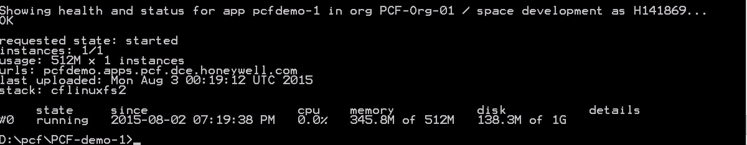
Full Stack Ticket Elimination
Firewall & Routes
Service Bindings
App Lifecycle
Runtime Installation & Config
Middleware Installation & Config
Application Installation & Config
App Lifecycle
Logging, Health, Telemetry

Slide 20





Pivotal Cloud Foundry at a Glance
Platform Runtime
Services
Routing
Container Scheduling
Service Discovery
Configuration
Database
Application Framework
Big Data
12 Factor Apps
Microservices
RESTful Services
Circuit Breakers
Object Storage
Mobile
Spring Boot
Ruby on Rails
Node.js
.NET
Build CI
User Provided
Logging & Metrics
Messaging
Operations
Zero Downtime Deployments
Failover & Recovery
Scaling
Security Patching
Platform
Upgrades
Azure

Slide 21

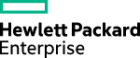
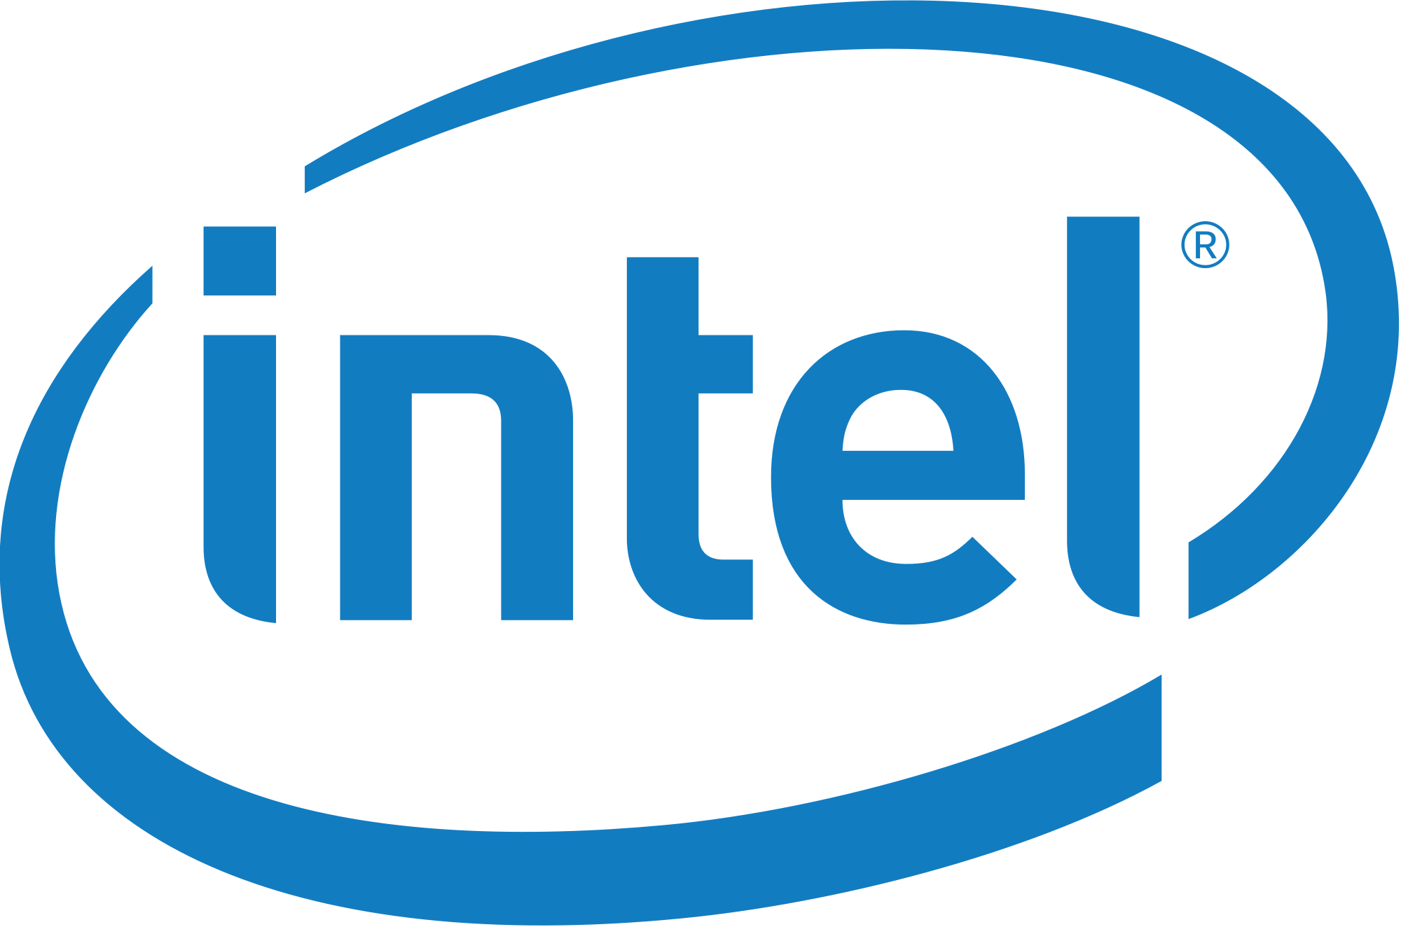
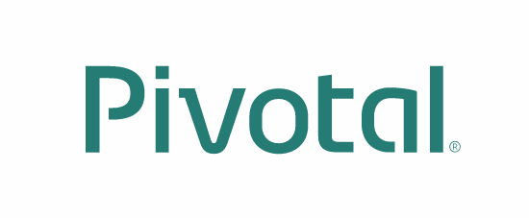





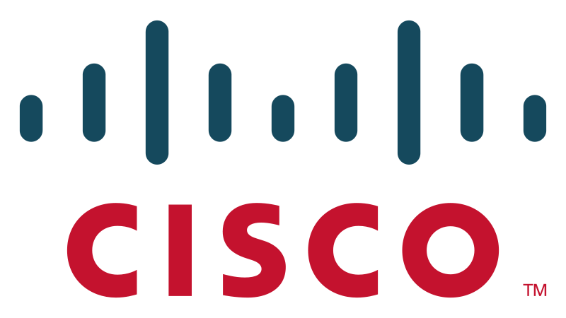


















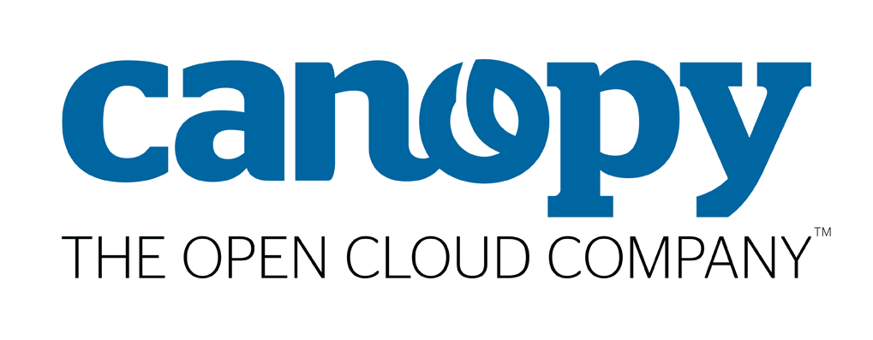
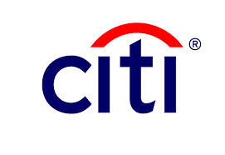
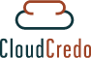










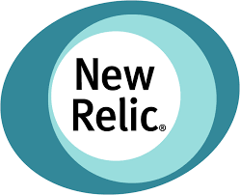



Pivotal Cloud Foundry
An Open Industry Standard
PLATINUM
GOLD
SILVER

Slide 22
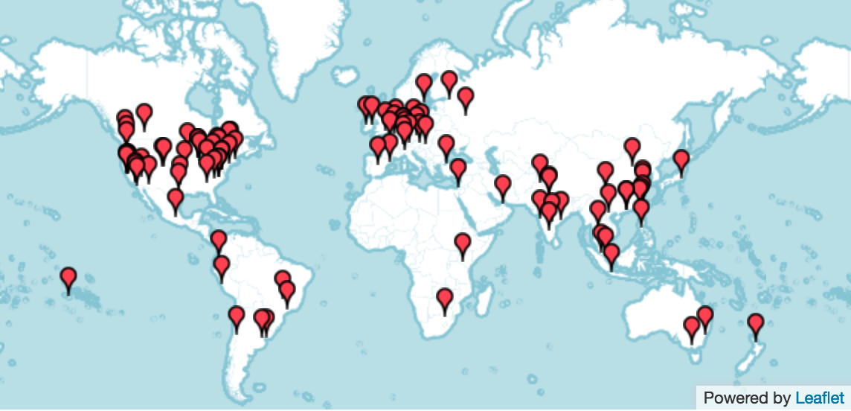
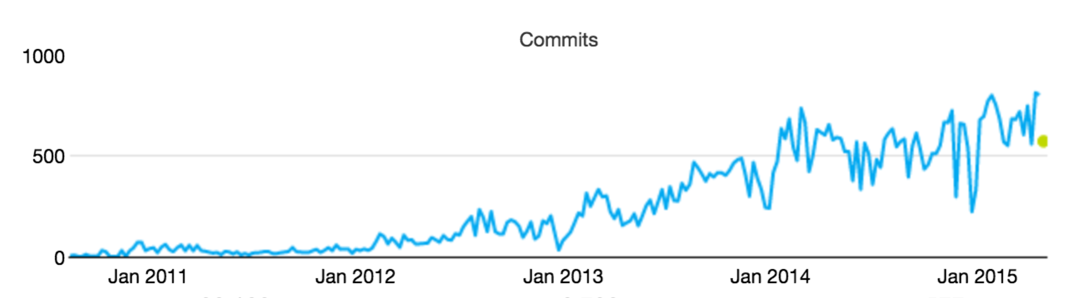
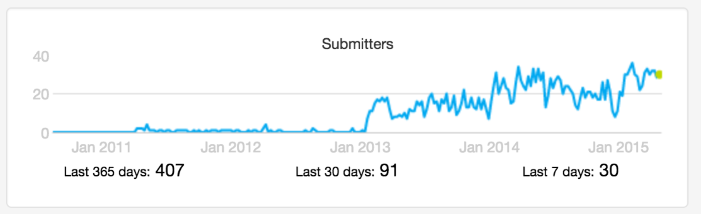
CF Open source momentum
Commits
Submitters
53 corporations are contributing members
158 meetups in 49 countries
21K members with ~5K joining last month
~2200 developers, ~650 Code Submitters, ~400 of them in last year
65K commits with ~30K of those in the last year
Source: http://cloud-foundry.meetup.com/ on Jun 12 2015

Slide 23
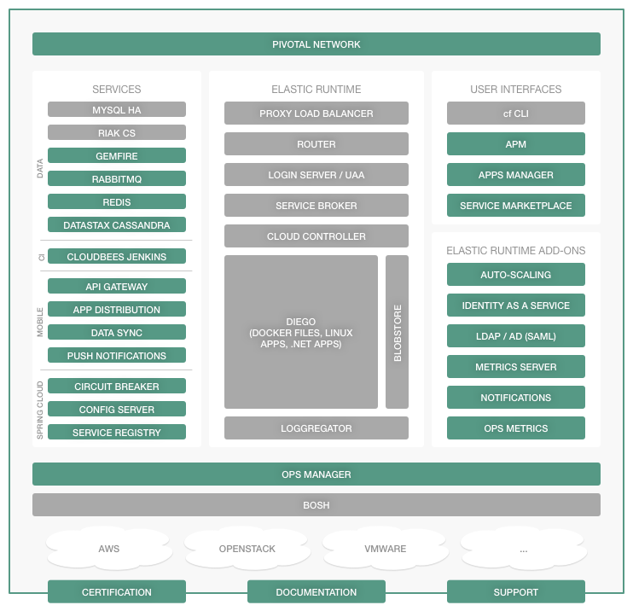
Pivotal Cloud Foundry Commercialization Model
Open source software provides the basis for the platform
Commercial distribution provides value add features, enterprise services, support, docs, certs etc.
Notes:
Our company may be young, but the codebase has developed over many years. Many of the original developers are still at Pivotal.
Cloud Foundry Open source software provides the foundation for the Pivotal Cloud Foundry platform. Commercial distribution provides enterprise services, support, docs, certs etc.
For more differences between Opensource and PCF: https://sites.google.com/a/pivotal.io/inside-pivotal-competitive-intelligence-page/oss

Slide 24
B r e a k

